Slide 1
Digital Portfolio
STUDENT NAME: B.ABISHA
REGISTER NO AND NMID: autunm1455unm1455bca3199139
/2EF71043AB3E0E5B9464948FD44E198C
DEPARTMENT: BCA
COLLEGE/ UNIVERSITY:TAGORE COLLAGE OF ARTS & SCIENCE
MADRAS UNIVERSITY

Slide 2
PROJECT TITLE
ABISHA PORTFOLIO

Slide 3


AGENDA
End Users
ToProject Overview
Problem Statement
Tools and Technologies
Portfolio design and Layout
Features and Functionality
Results and Screenshots
Conclusion
Github Link
3/21/2024 Annual Review

Slide 4

PROBLEM STATEMENT
What’s there now:
The portfolio doesn’t explicitly state the “problem” it solves.
What you should include:
Describe why you built the portfolio. For example:
Showcasing your web development skills to attract clients or employers.
Demonstrating how you translate design concepts into functional web pages.
Clarify what gap it addresses—e.g., limited online presence, need for a personal brand, or acting as a unified showcase of your work.

Slide 5

PROJECT OVERVIEW
The site presents Abisha B, a web developer from Tamil Nadu. It includes simple navigation—Home, About, and Contact—and aims to introduce who you are and invite connection. However, due to minimal content, it's hard to provide more depth on what the project aims to solve or achieve.

Slide 6

WHO ARE THE END USERS?
Primary visitors would likely be potential clients, recruiters, collaborators, or anyone interested in your work who wants to learn about you or reach out. The "Contact" link implies the site’s intent is to facilitate connections.

Slide 7

TOOLS AND TECHNIQUES
The site appears to be a static portfolio, which suggests it’s built using basic web technologies—likely HTML, CSS, and possibly hosted via GitHub Pages. There is no visible evidence of frameworks like React, Gatsby, or Jekyll, nor any scripting.

Slide 8
POTFOLIO DESIGN AND LAYOUT
Design: Minimalist and clean. You have a simple navigation bar linking to Home, About, and Contact.
Layout: Very sparse—presenting just your name (“Abisha B”), a professional tagline (“I’m a web developer from Tamil Nadu”), and copyright notice. There’s a placeholder for an image, but no other sections.
8

Slide 9
FEATURES AND FUNCTIONALITY
Right now, the site is very basic:
Navigation links (Home, About, Contact) are present.
An image placeholder is visible (but content isn't shown).
There’s no interactive functionality (forms, animations, project galleries).
No indicators of dynamic behavior or advanced features.

Slide 10

RESULTS AND SCREENSHOTS
While I can't directly provide screenshots, here’s what the results indicate:
A professional-looking portfolio that communicates skills and personality.
Clearly visible projects and descriptions help users understand competencies.
Structured sections make navigation intuitive.
3/21/2024 Annual Review
10

Slide 11
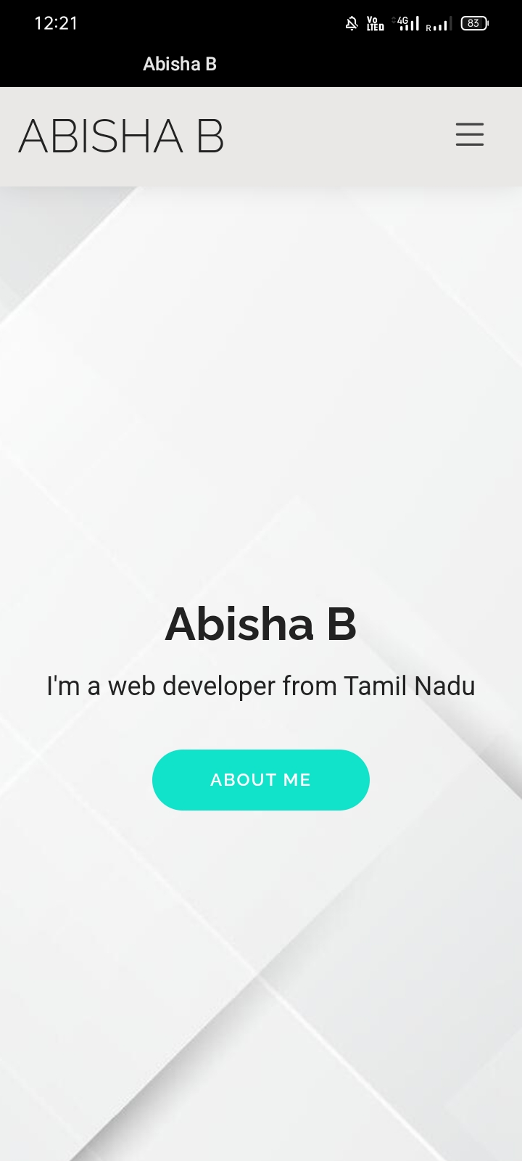
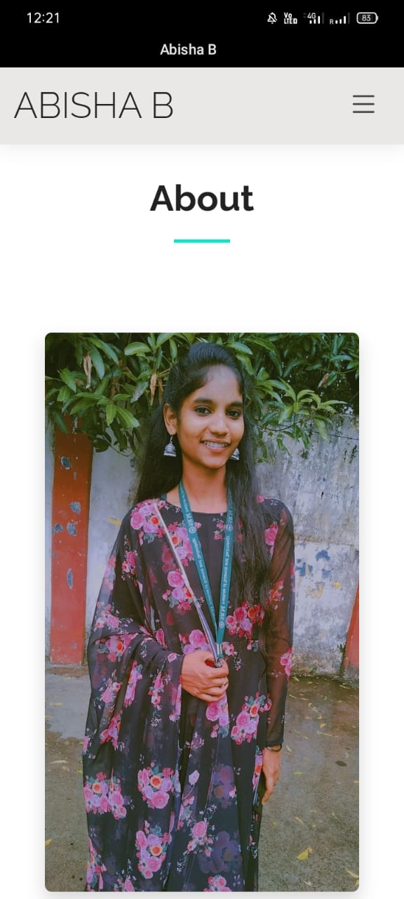
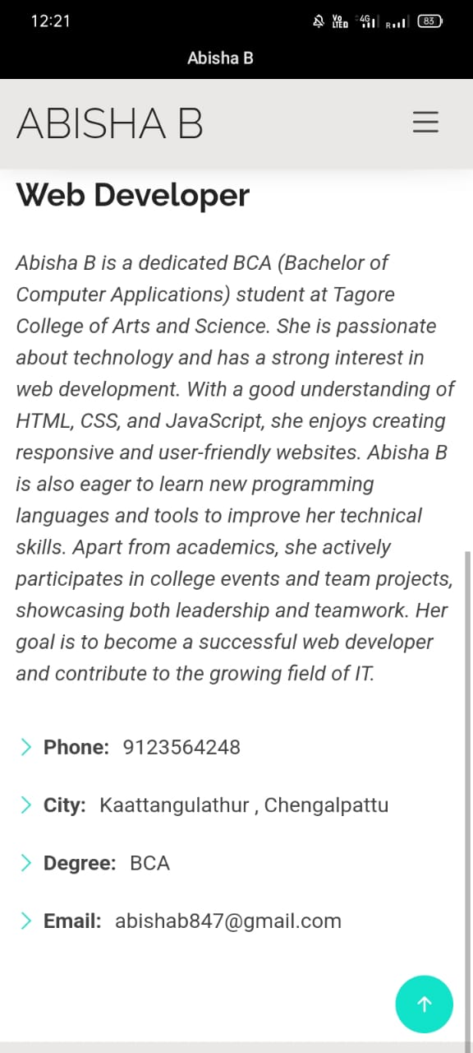

Slide 12
CONCLUSION
This portfolio website serves as a crucial stepping stone for personal branding in the tech industry. It provides a centralized platform for the developer to present themselves professionally and connect with opportunities. The use of standard web technologies ensures wide compatibility and fast load times, while the design ensures clarity and engagement.
12

Slide 13

https://abisha213.github.io/My_Portfolio/about.html

